Slide 1
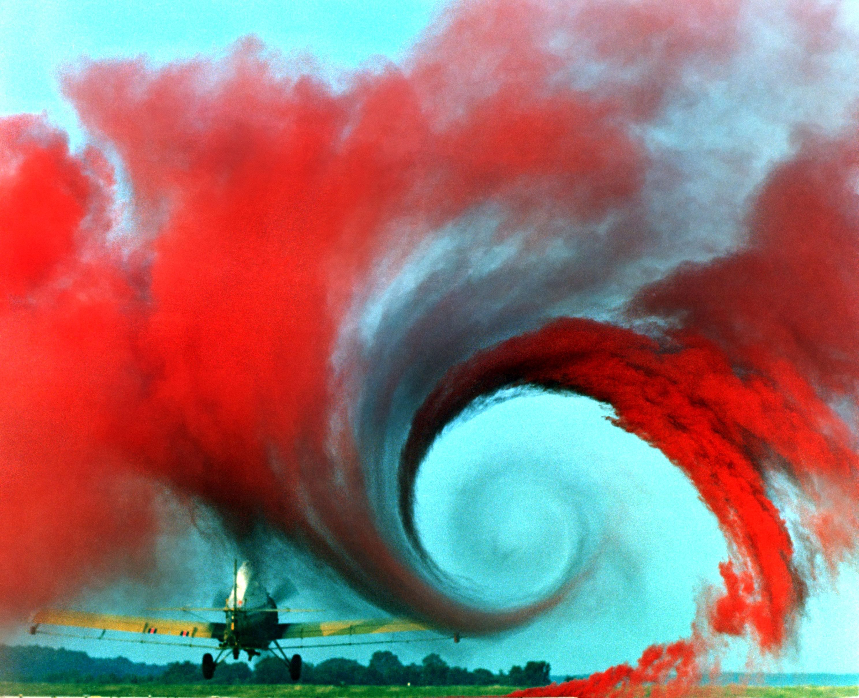
Navier-Stokes at High Reynolds Numbers

Slide 2


Motivation: turbulence on the nanoscale
“Planckian fluid” on the nanometer scale. Fermi-liquid guised Reynolds gives order:
Expressing length and velocity in natural units:
Strange Metal at 1K, Re = 100 000 000 v_tr / v_mu
YBCO at T=100K, just above critical: Re = 10 000 v_tr/v_mu
Turbulent flows in a nanoscale system!
$$Rⅇ=\frac{\sqrt{2}}{y_{7}}∘\frac{L_{a}}{l_{μ}}⋅\frac{v_{tr}}{vμ}⋅\frac{μ}{k_{B}T}$$
$$Rⅇ=\frac{μ}{k_{B}T}$$

Slide 3
Can we solve this with Engineering techniques?
Benefit:
  different materials
  different spatial arrangements
  Rapidly posing problems
Drawbacks:
  Makes assumptions to simplify problem
  Slower code (framework overhead)
Conclusion?

Slide 4
Direct Navier Stokes
Industry-standard: Prediction-Projection method
  (simplified) “U star” ~ u( t+dt) “predict Navier-Stokes”
  Use to calculate p(t+dt) “Solve Continuity”
  Then update u(t+dt) “Project Navier-Stokes”
C++14/OMP: Cluster optimization
However:
  Stability issues
  Very hard to implement
  Assumptions build into core of process
  This is an instate for Physics, not CFD

Slide 5
Results: Engineering CFD
(Movie time)

Slide 6
Results: Lattice Boltzmann Method
(SPTCM school)
Gallery time

Slide 7
What now?
direct NS solver:
  Implementation taken care of
  Focus holo/hydro, not CFD
Pose problems (e.g. candle flame)
… Next sprint:
  Candle flame
  Global vs local measurements of turbulence?
  Near-boundary local measurements?

